Slide 1

DEPARTMENT OF
COMPUTER SCIENCE AND ENGINEERING
GUIDED BY :
TEAM MEMBERS :
Mrs R. SHARIFF NISHA
[AP , CSE]
BALA S [811320104003]
HARIHARRASUDHAN V [811320104301]
MATHIYAZHAGAN D [811320104013]
RAJESH K [811320104019]

Slide 2
BASE PAPER
Cheat Detection for Credit Cards Using Artificial Intelligence
Author:
Salomi Hurriya Anjum
Geeta Patil

Slide 3

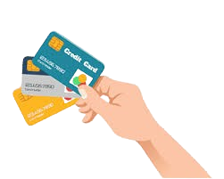

CREDIT CARD TRANSACTION BASED ON FACE RECOGNITION TECHNOLOGY USING AI

Slide 4
OUTLINE
AIM
OBJECTIVES
DOMAIN
ABSTRACT
INTRODUCTION
LITERATURE SURVEY
EXISTING SYSTEM
PROPOSED SYSTEM
SYSTEM SPECIFICATION
DATA FLOW DIAGRAM
SYSTEM ARCHITECTURE
MODULE LIST
SAMPLE OUTPUT
METHODOLOGY
CONCLUSION
FUTURE ENHANCEMENT
REFERENCE

Slide 5
AIM
AI-driven facial recognition technology to create a secure, efficient, and user-friendly credit card transaction system .
It enhances security, reduces fraud, and improves the overall payment experience for consumers.
Continuously monitor the performance of the face recognition system in production, collecting feedback and data to identify areas for improvement.

Slide 6
OBJECTIVES
Improve the security of credit card transaction process in E-Commerce application using face recognition technology.
Once the face detection process is completely finish then user can move on to the next process.
An e- mail notification is sent to the customer as soon as the order is placed.

Slide 7
DOMAIN (ARTIFICIAL INTELLIGENCE)
Artificial Intelligence (AI) is a branch of computer science that focuses on creating systems capable of performing tasks that typically require human intelligence.
Artificial Intelligence (AI) refers to the simulation of human intelligence in machines that are programmed to mimic cognitive functions such as learning, problem-solving, reasoning.
AI has applications across various industries, including healthcare, finance, transportation, manufacturing, and entertainment.

Slide 8
ABSTRACT
In real time payment modes have different modes such as cash on delivery, online transaction, credit card transaction ,etc.
Online transactions take place, the customer involves option for credit/debit cards or internet banking.
During online transactions there are many chances to steal the confidential information by the attackers or hackers.
Implement the framework to recognize the face using Grassmann algorithm at the time of transactions with improved accuracy rate
Post the complaints about unknown person access at the time of transactions

Slide 9
INTRODUCTION
The main problem faced by credit card user is attack to lot of privacy issues.
The cards can be stolen or duplicated, giving unauthorised people access to resources.
This generally happens when users give their credit card to unknown people or when the card is lost.
Implement a system that will reduce the risk of credit card frauds during the transaction.
Proposed method for credit card transaction system which will make use of face recognition and face detection technology using web application.

Slide 10
LITERATURE SURVEY
S.No | Title | Authors & Year | Algorithm | Merits | Demerits
1 | A dual approach for credit card fraud detection using neural network and data mining techniques | Sahu, Aanchal, G. M. Harshvardhan, and Mahendra Kumar Gourisaria - 2023 | Logistic Regression (LR) | It is simple to expand to different classes. | The complex challenges are hard to resolve.
2 | Credit card fraud detection through machine learning algorithm | Panda, Agyan, Bharath Yadlapalli, and Zhi Zhou - 2023 | Random Forest (RF) | It is adaptable to problems involving classification and regression. | It needs a lot of computing power.

Slide 11
LITERATURE SURVEY
S.No | Title | Authors & Year | Algorithm | Merits | Demerits
3 | Credit Card Fraud Detection Using Support Vector Machine | Kumar, Sheo, Vinit Kumar Gunjan, Mohd Dilshad Ansari, and Rashmi Pathak - 2022 | Support Vector Machine(SVM) | High Dimensionality Scaling That Is Remarkably Good | Selecting An Adequate Kernel Value Might Be Challenging.
4 | Credit Card Fraud Detection Systems (CCFDS) using Machine Learning (Apache Spark) | Vinaya, D. S., Satish B. Basapur, Vanishree Abhay, and Neetha Natesh - 2022 | Gradient-Boosted Trees (GBTs) learning algorithm for classification. | It is a versatile algorithm that handles any differentiable loss function. | High Installation Costs

Slide 12
LITERATURE SURVEY
S.No | Title | Authors & Year | Algorithm | Merits | Demerits
5 | Credit card fraud detection using machine learning: A survey | Lucas, Yvan, and Johannes Jurgovsky - 2022 | Long Short Term Memory (LSTM) | Cost-Effective | Different random weight initializations can affect LSTMs.

Slide 13
EXISTING SYSTEM
Different Algorithms and techniques have been designed to implement the facial recognition as a key element for authentication of card holder.
Many institutions use e-ID cards as access control authorization, it means that one just needs to possess card in order to get access.
In such a scenario it is sufficient to steal or duplicate a card of legitimate user in order to get all its credentials.
Based on these arguments existing framework propose a new solution preventing from using electronic cards by unauthorized persons as well as limiting the usage of stolen cards.
Simultaneously the whole system should be as transparent as possible for users and not force them to change their habits in major way.

Slide 14
DISADVANTAGES
Existing models haven’t been widely used in fraud detection of credit card fraud.
This method may require significant computational resources and its performance can vary depending on the dataset.
It only focuses on dataset based fraud classification, does not avoid the fraudulent activities.
Need to enhance the application for real time fraud analysis in credit card transactions.

Slide 15
PROPOSED SYSTEM
The most common modes of payment during an online transaction are credit and debit cards.
Proposes a model for credit card authentication using face recognition and face detection in E-Commerce framework.
In this model, Grassmann algorithm has been used with real time framework for accurately recognizing the user’s face.
And also design the system to know the unauthorized access in terms of mail alert.

Slide 16
ADVANTAGES
Face authentication provides complete security of the proposed method.
Overcome the guessing attacks and dictionary attacks
No need to implement additional sensors
EMAIL alert to know about transactions details up to date.

Slide 17
HARDWARE REQUIREMENTS
Processor : Intel Pentium 4
RAM : 4 GB
Hard disk : 160 GB
Compact Disk : 650 Mb
Keyboard : Standard keyboard
Monitor : 15 inch color monitor

Slide 18
SOFTWARE REQUIREMENTS
Operating system : Windows OS
Front End : HTML5 , CSS, JS
Back End : Python
Database : MySQL Server
Tool : VS code

Slide 19
DATA FLOW DIAGRAM
Credit Card Transaction Based On Face
Recognition
Admin
User
Level 0
Database
Login
Store the data
Level 1
Admin
Add Product
Store the data

Slide 20
DATA FLOW DIAGRAM
User
Enrolment
Product Purchase
Face Recognize
Level 2
Make Payment
Database

Slide 21
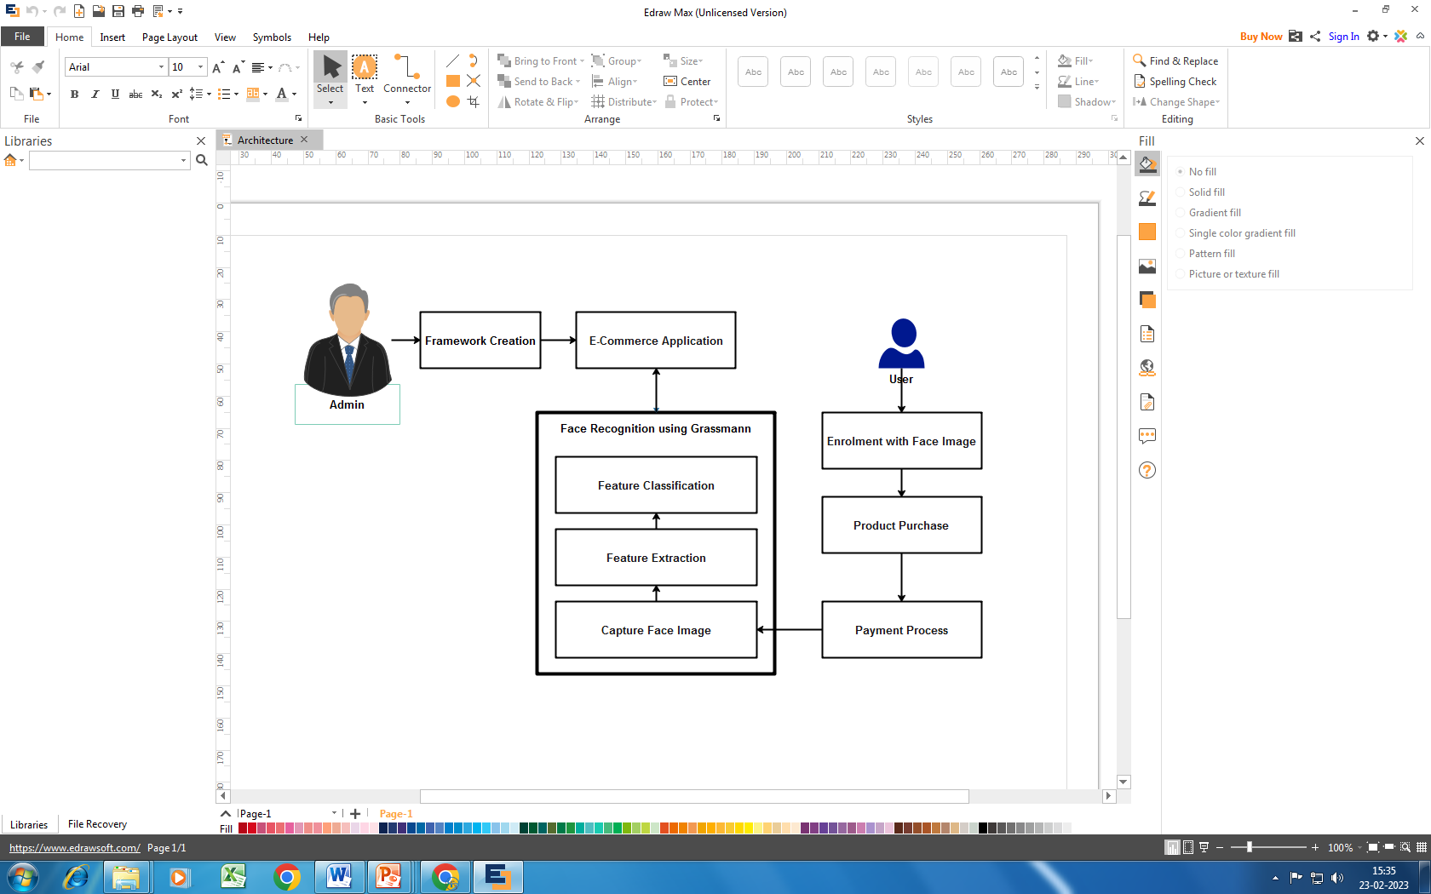
SYSTEM ARCHITECTURE

Slide 22
MODULE LIST
Framework Creation
Purchase Product
Payment Using Face Recognition
Face Classification
Payment Process

Slide 23
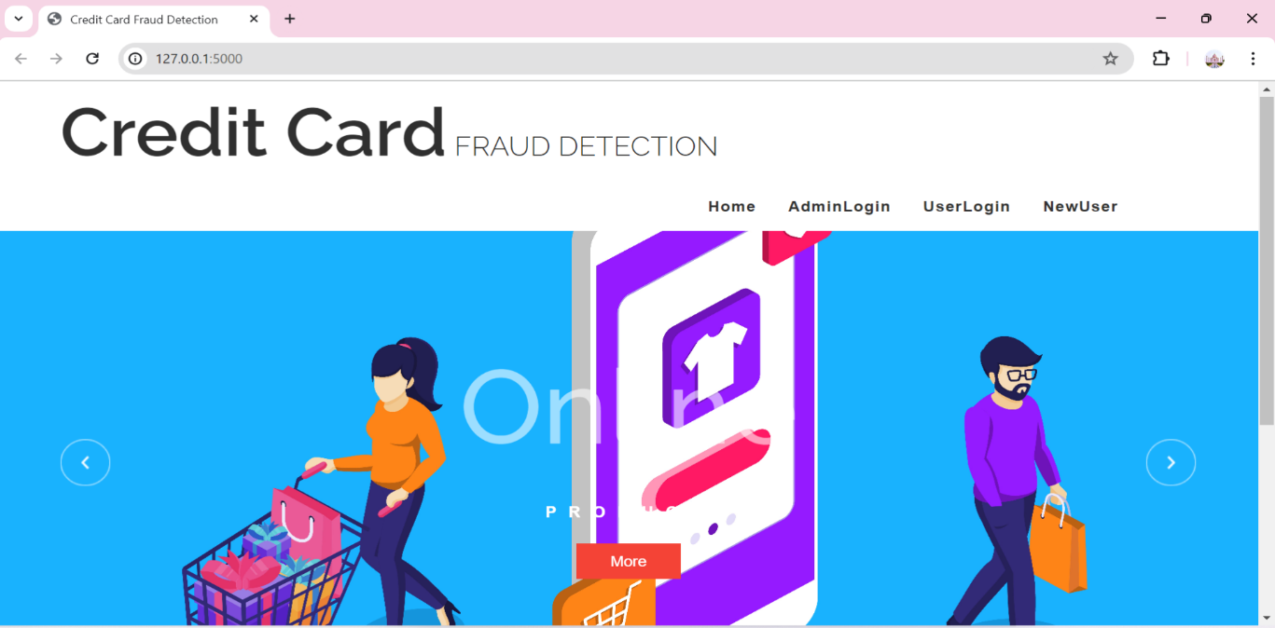
MODULE DESCRIPTION FRAMEWORK CREATION
Framework creation is the process of developing E-commerce application with proposed facilities.
In this application admin can add the product details like product id, name, type, amount, so on.
Then user can create their account by providing required information.
Here user’s face is captured through web cam and registered in database for further verification.

Slide 24
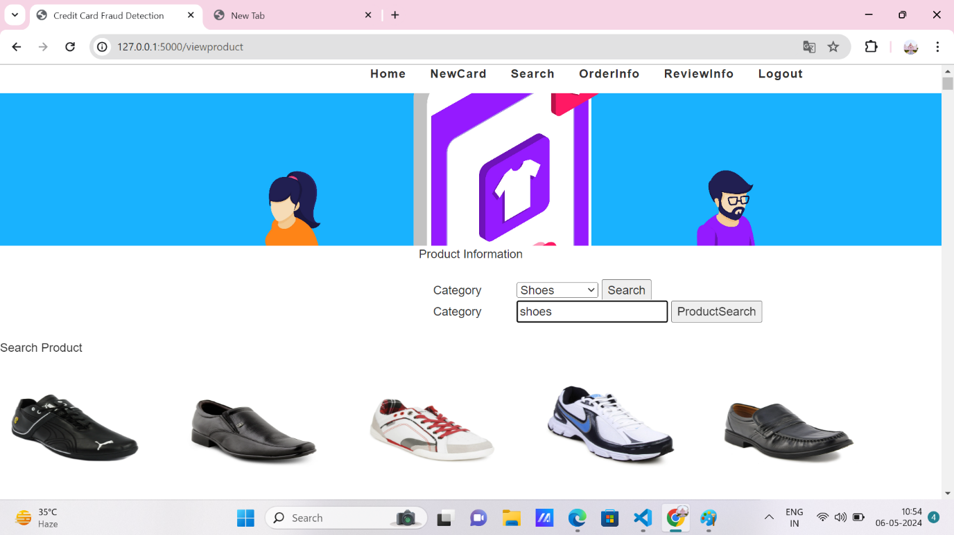
MODULE DESCRIPTION PURCHASE PRODUCT
In this module, user can login in E-Commerce application and search product for purchasing.
The user can view the product details like product name, type, amount, description etc.
After viewing all products, the user can select product based on their need.
The user’s purchase details are sent to the admin.

Slide 25
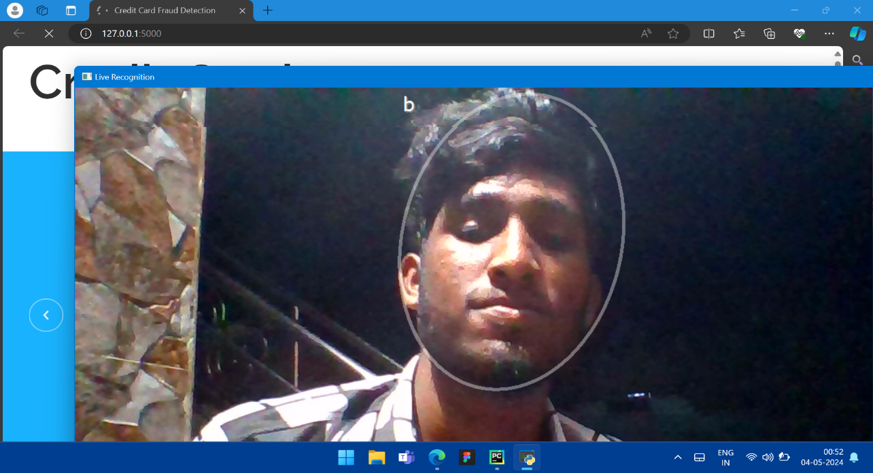
MODULE DESCRIPTION FACE IMAGE ACQUISITION
In proposed E-Commerce application user can make payment securely with the help of face recognition approach.
This module contains user’s card details like name, card no, amount etc.
After successfully entered the card details the system, user’s face image was captured with the help of web camera.
Then the captured face image compared with particular card holder account database.

Slide 26
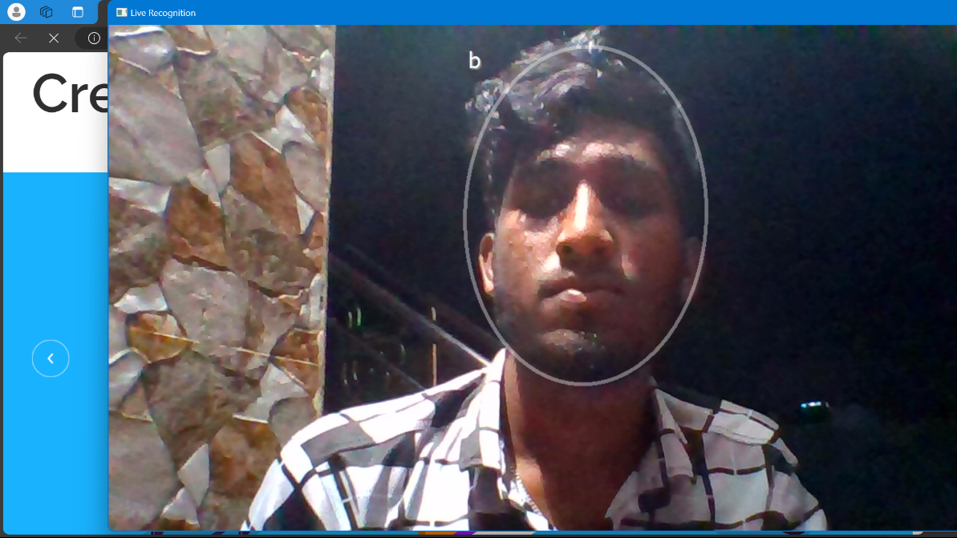
MODULE DESCRIPTION FACE CLASSIFICATION
It is the process of extraction facial features and compared with database for user verification.
Facial highlights such as nose part, eye parts and lip part are extracted and these qualities are put away as grid.
The framework can be shaped by utilizing Grassmann manifold learning computation.
The feature data of particular facial image helps its application as a biometric identifier for individual acknowledgment.

Slide 27
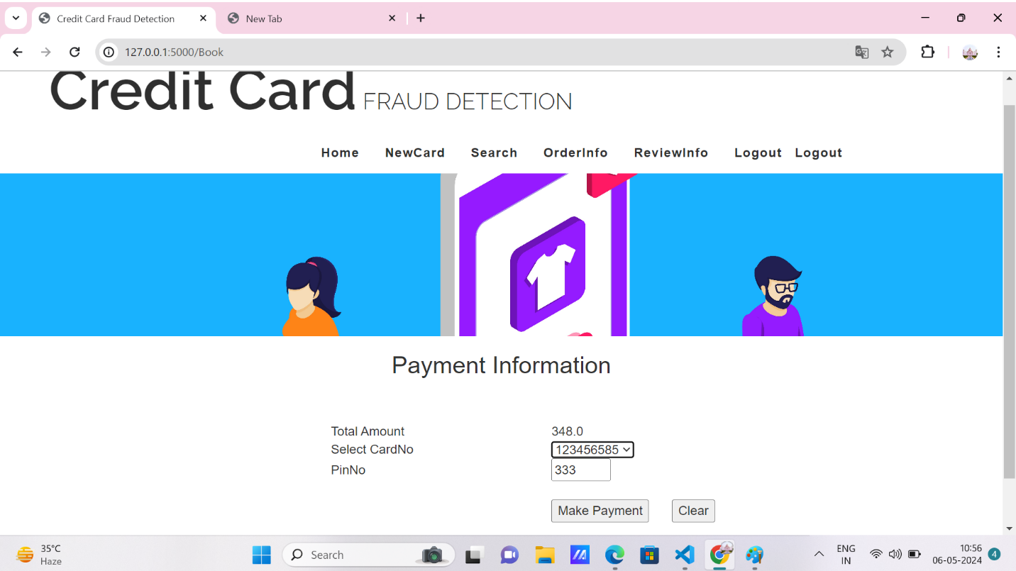
MODULE DESCRIPTION PAYMENT PROCESS
Once the face detection process is completed then user can move on to the payment process.
Here user can enter the amount that should be transferred. Then the amount transaction will complete in a secure manner.
When the classification process got failures to detect the face image or identify the fake user the system will automatically send e- mail notification to the customer as soon as the order is placed.

Slide 28
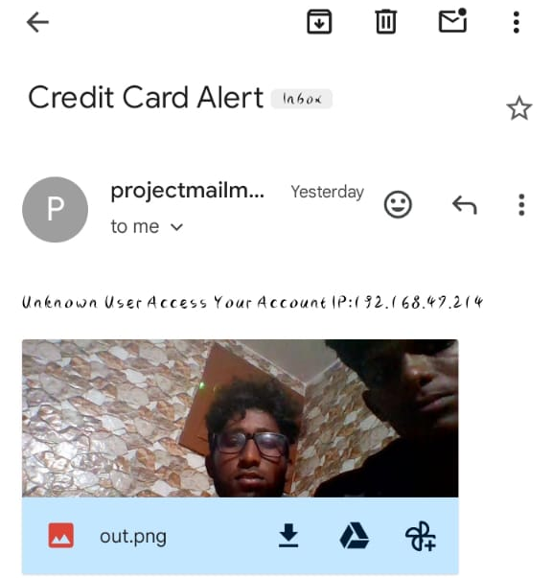
SAMPLE OUTPUT

Slide 29
METHODOLOGY
Grassmann manifold learning:
Step 1: Read the face boundaries from video frames.
Step 2: Boundary values are constructed as feature vectors.
Step 3: Predict the tangent vector.
Step 4: Calculate distance values from query frames with still images.
Step 5: If distance value is equal to zero or less than the minimum means, match found.
Step 6: Otherwise send alert about unknown person.

Slide 30
CONCLUSION
This project entitled as “Credit Card Transaction Based on Face Recognition Technology” has been developed to satisfy all the proposed requirements.
The system reduces the possibility of errors to a great extent and maintains the data in an efficient manner.
User friendliness is the unique feature of this system.
The system generates the reports as and when required. The system is highly interactive and flexible for further enhancement.

Slide 31
FUTURE ENHANCEMENT
While face recognition technology can be an effective way to prevent fraud, it's not fool proof.
Future work could focus on developing additional security measures, such as multi-factor authentication or biometric sensors, to further enhance the security of credit card transactions.
Also focus on expanding the usability of this technology so that it's available to more consumers and businesses.

Slide 32
REFERENCE
[1] Sahu, Aanchal, G. M. Harshvardhan, and Mahendra Kumar Gourisaria. "A dual approach for credit card fraud detection using neural network and data mining techniques." In 2020 IEEE 17th India council international conference (INDICON), pp. 1-7. IEEE, 2020.
[2] Panda, Agyan, Bharath Yadlapalli, and Zhi Zhou. "Credit card fraud detection through machine learning algorithm." Big Data and Computing Visions 1, no. 3 (2021): 140-145.
[3] Kumar, Sheo, Vinit Kumar Gunjan, Mohd Dilshad Ansari, and Rashmi Pathak. "Credit Card Fraud Detection Using Support Vector Machine." In Proceedings of the 2nd International Conference on Recent Trends in Machine Learning, IoT, Smart Cities and Applications: ICMISC 2021, pp. 27-37. Springer Singapore, 2022.
[4] Vinaya, D. S., Satish B. Basapur, Vanishree Abhay, and Neetha Natesh. "Credit Card Fraud Detection Systems (CCFDS) using Machine Learning (Apache Spark)." (2020).
[5] Lucas, Yvan, and Johannes Jurgovsky. "Credit card fraud detection using machine learning: A survey." arXiv preprint arXiv:2010.06479 (2020).

Slide 33
THANK YOU

